Slide 1
Software Engineering and Architecture
Mandatory Reflections

Slide 2
Congrats !
You have covered a lot of ground!
There are only three out of nine exam topics that we still have to cover!
And one of these (frameworks) is actually more or less covered…

Slide 3
StudyCafe Experience
Private Interface?
Perhaps should be renamed to ‘friend interface’
Your friends are allowed to ‘make more private requests’ than a stranger is…
So, a Card should expose a ‘private interface’ to its good friend, the Game,
“Dear Game, you are allowed to change my health”
Whereas, a stranger (the UI) is not…
Interface MutableCard extends Card { void changeHealth(…); }

Slide 4

Stubs vrs Spies
Stub/Spy are categories of test doubles
I.e. they are roles a double may play
And it may play both and often do!
Indeed – to make a MutableGameSpy work so it can help us test the card effects, it needs to feed ‘stub’ indirect input.
Example: Brown Rice effect likely needs to call ‘game.getPlayerInTurn()’ to compute the opponent…
My ‘spy’:

Slide 5
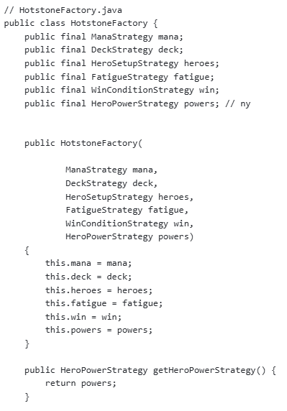
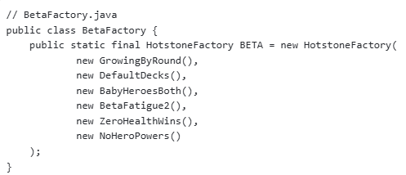

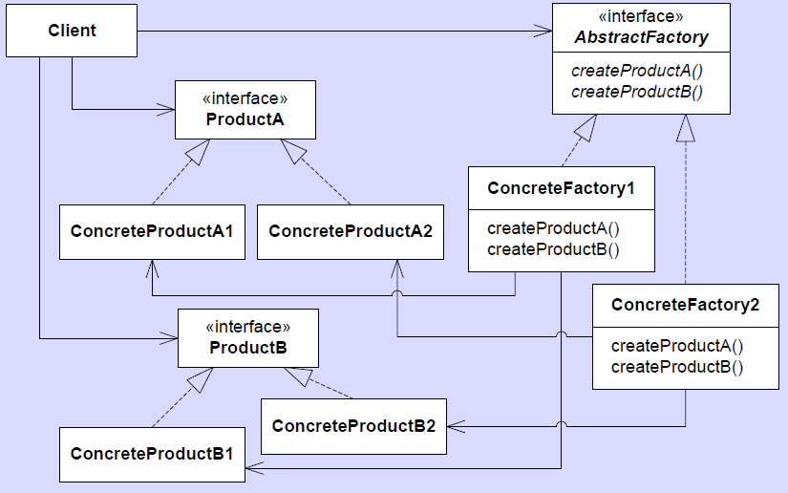
Static Fields?
?

Slide 6
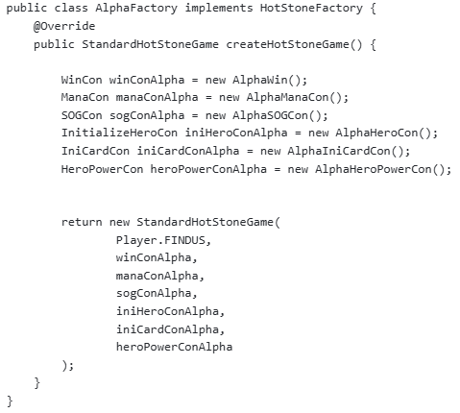
GameFactory?
Factories do not create Games !
In the UML, it translates to Factory Create Client!

Slide 7
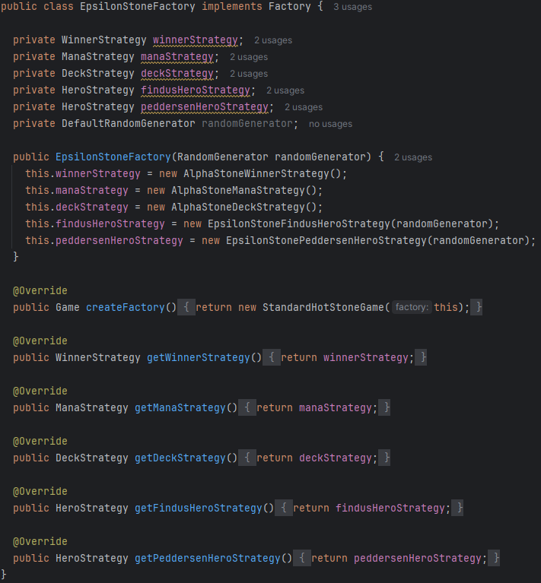
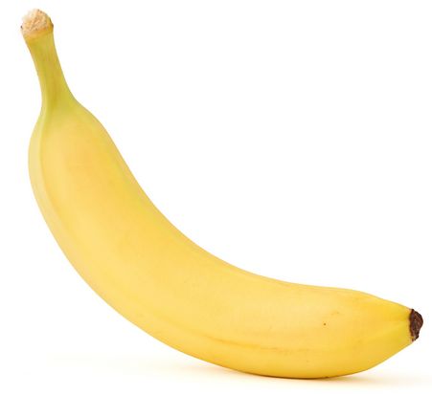
And a Mix
A bit of both?
‘createFactory()’ return game?
“This is an apple”

Slide 8
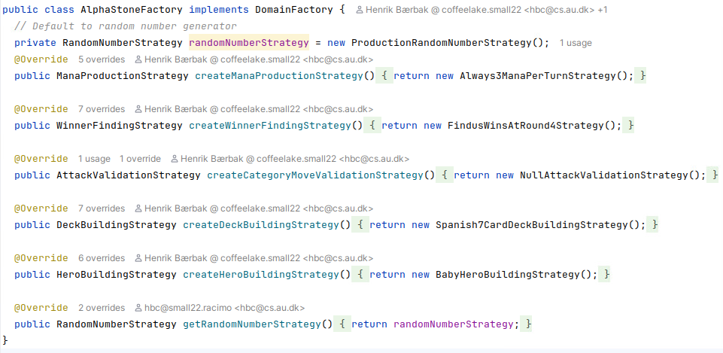
ProductFactory!
Factories creates the delegates that client uses

Slide 9
Factories Create stuff
Important naming of methods
A factory creates an object! It is not an accessor (‘get’-method) on the same object every time!
Call the method ‘createX()’ or ‘makeX()’, and never ever ‘getX()’!

Slide 10
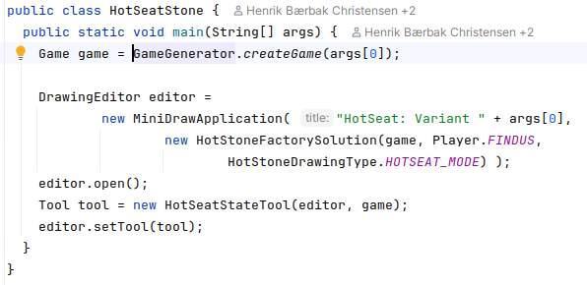
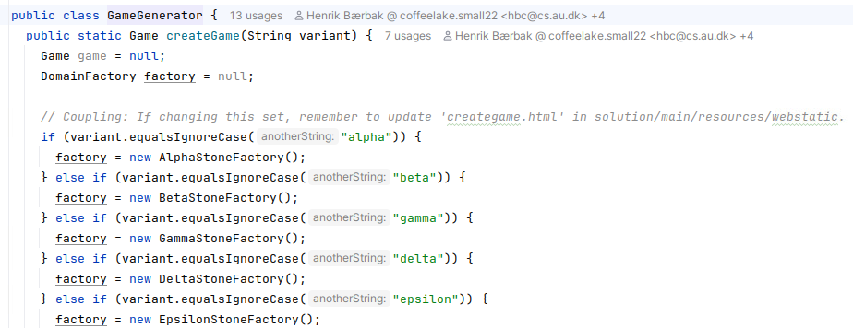

Main Method?
A ‘switch on a string’ is needed in Main():
‘gradle hotstone –Pvariant=alpha’
Putting that switch in its own abstraction does make sense!

Slide 11
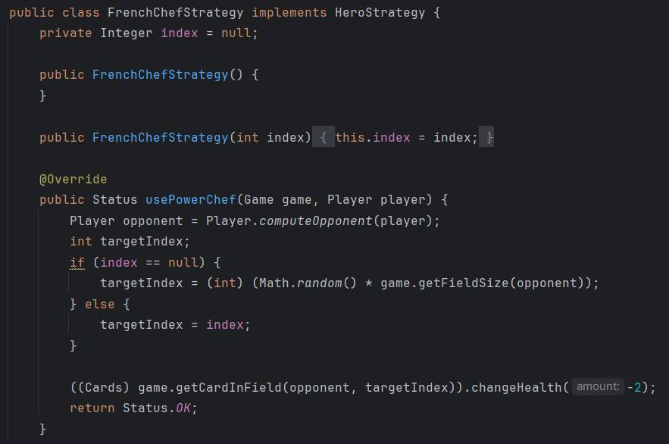
No Doubles in Production
What is the issue with this test stub?
Notes:
Answer: The test double / stub behaviour is not a replacement, but a parametrisk solution in the production code and runs the risk that someone will turn it on in production

Slide 12
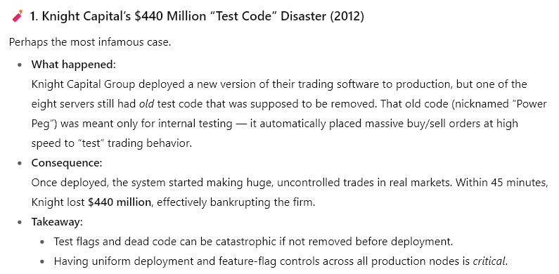

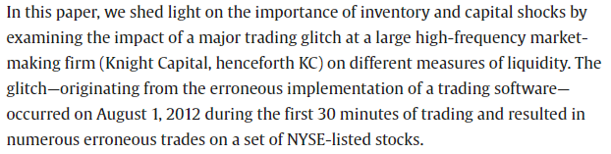
Test Code in Production
One such example
Thanks to ChatGPT

Slide 13
From 2024

Slide 14
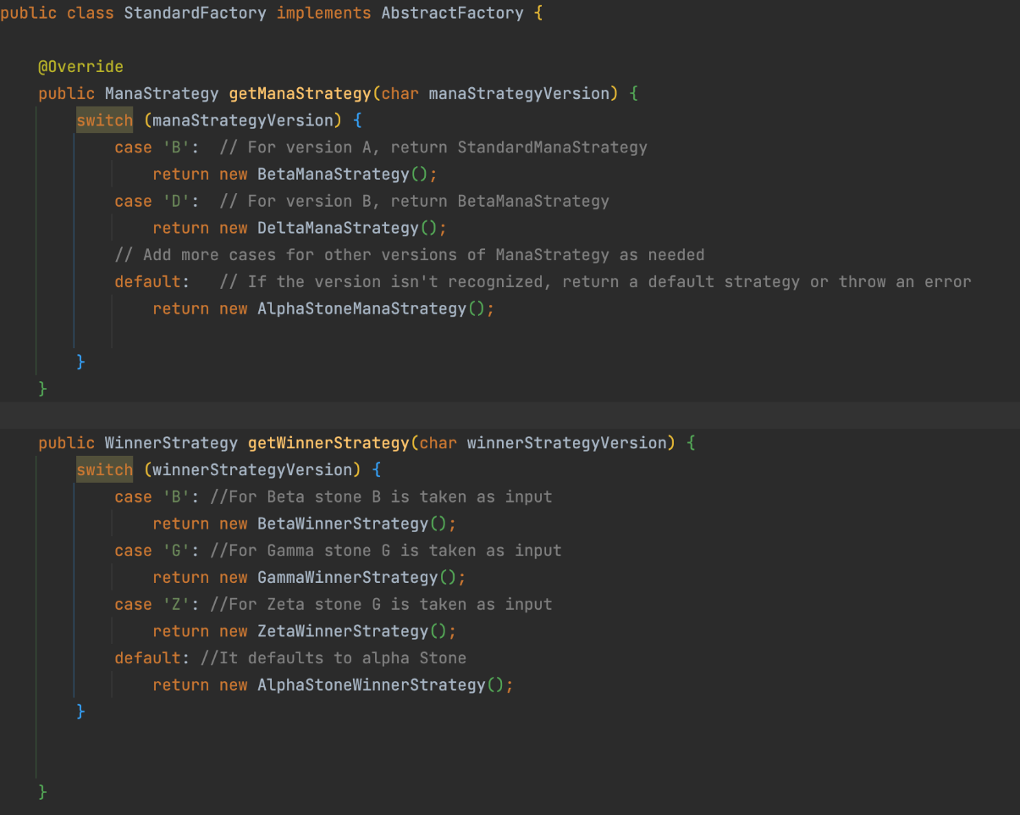
Parametric Factory
What is the problem here?

Slide 15
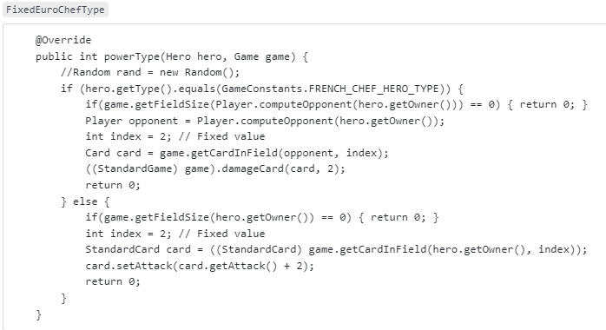
Kata : Trap not avoided
Issue?

Slide 16
Pesky Spy Exercise

Slide 17
First Year With Strong Spy Focus
… so pardon for annoying you with some sharp corners
Observation
A test spy is not an object that cannot have stub behavior
Indeed – to make a MutableGameSpy work so it can help us test the card effects, it needs to feed ‘stub’ indirect input.
Example: Brown Rice effect likely needs to call ‘game.getPlayerInTurn()’ to compute the opponent…

Slide 18
Spy With Stub Behavior
So my spy, for testing eta stone cards does include stub methods, like

Slide 19
Stubs with Stubs
I saw quite a few whose card effect strategies retrieve Hero and Card instances
Like fetching the Card, c, that game must mutate ala
mutableGame.reduceHealthOf(c, -2);
Thus the ‘MutableGameSpy’ must thus make ‘stub objects’ for Card to serve the ‘fetching’
Card getCardInField(…); must return card objects
☹ - lots of coding…

Slide 20
One insight
One insight to reduce this effort (significantly) is that every hero and every card is identifiable via simple data types!
Hero ‘who is it FINDUS or PEDDERSEN’
Card ‘field index 0..n’
So instead of
reduceHealthOf(Card c, int delta)
Use
reduceHealthOf(int fieldIndexOfCard, int delta)
Similar for hero: use ‘Player’ as type, not ‘Hero’
reduceHeroHealth(Player who, int delta)

Slide 21
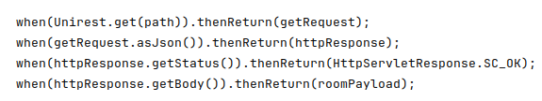
But – it is not uncommon
I used Mockito for creating test doubles for SparkJava’s HTTP library and ended with “deep doubling”
When GET on url
I get a Request object
That get a httpRequest object
That should return OK for ‘getStatus()’
TEDIOS to have deep path of objects to be doubled

Slide 22
Casting Avoided?
I may have said that introducing, say, MutableCard makes StandardGame free of castings…
Like Map<Player, List<MutableCard>> fieldMap =…
Avoid casting to StandardCard or references to it…
Not quite true. Free of casting to class but not free of casting to interface
attackCard(…, Card attackingCard, …)
Need to be cast ala
MutableCard asMutableCard = (MutableCard) attackingCard;
Exercise:
Why is cast to interface much better than cast to class?

